Slide 1
East or west?
May, 5

Slide 2

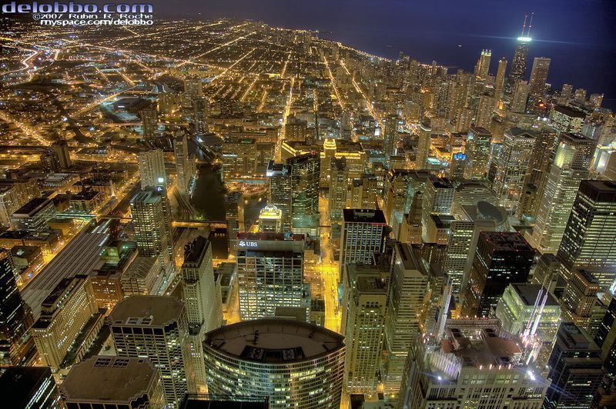
Where do you prefer to live?

Slide 3
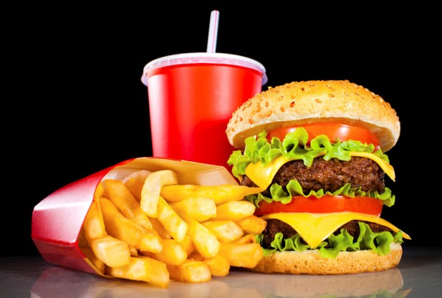
Fast food

Slide 4
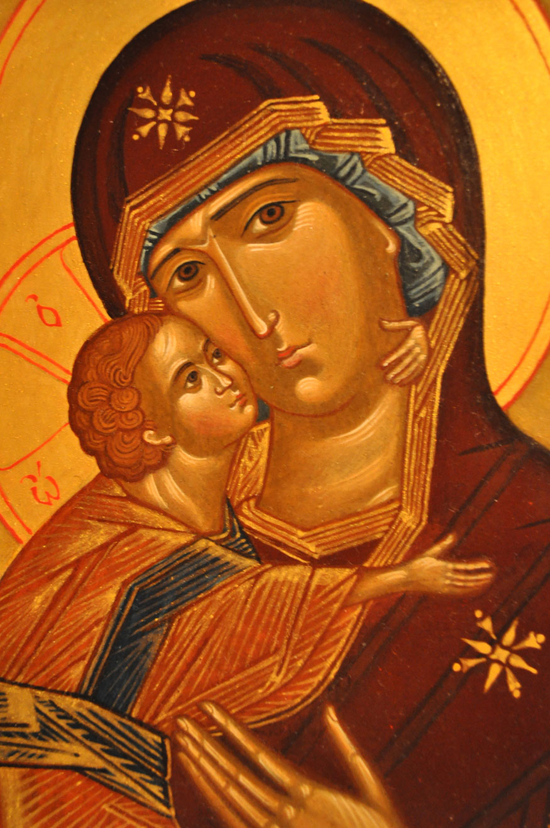
icon

Slide 5
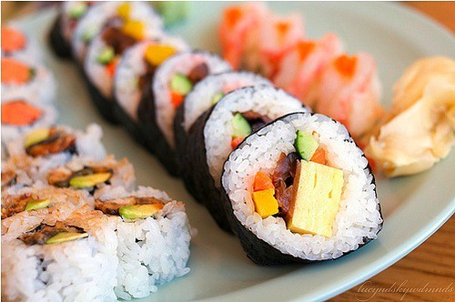
Sushi, kimono

Slide 6

coffee

Slide 7
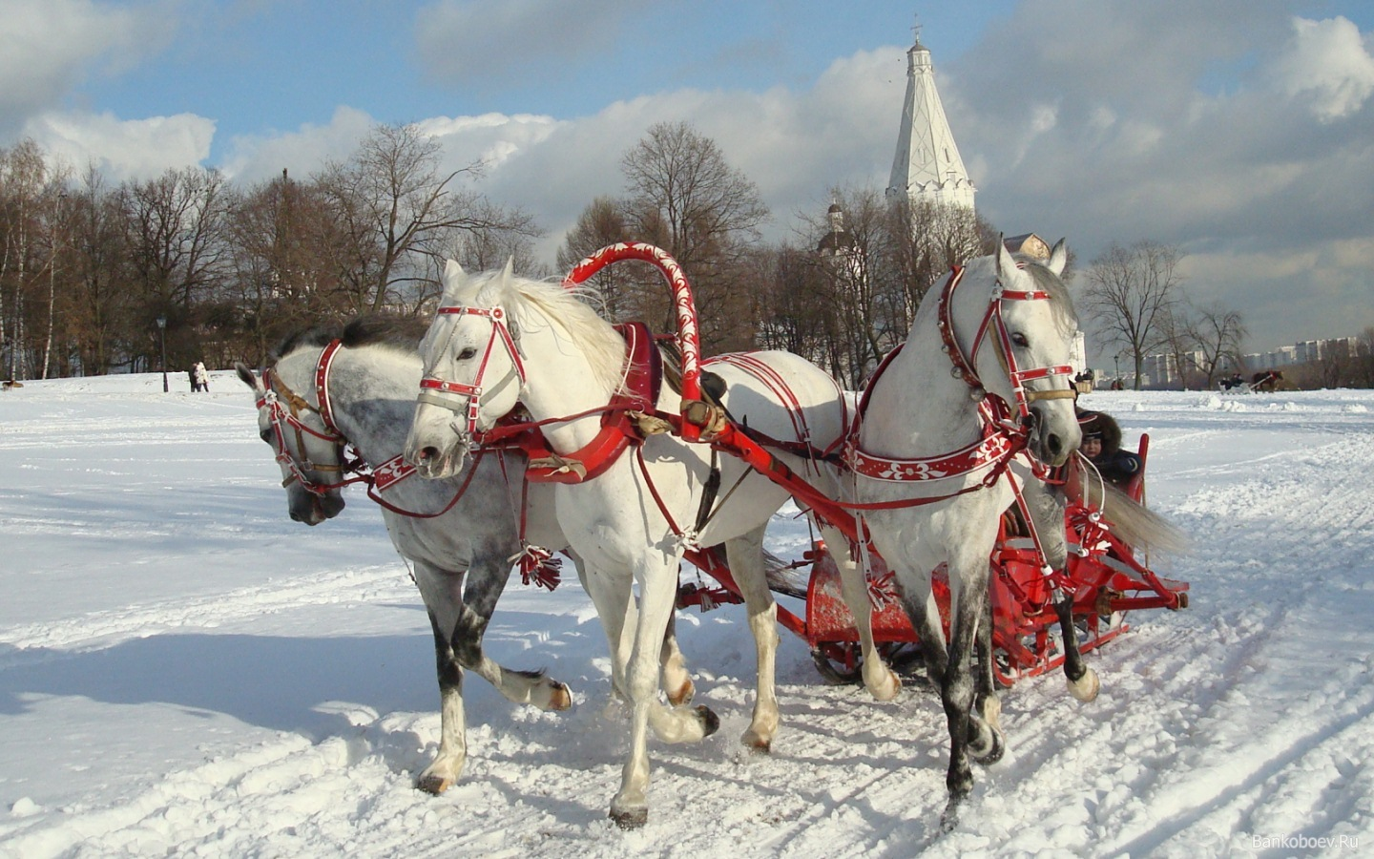
troika

Slide 8
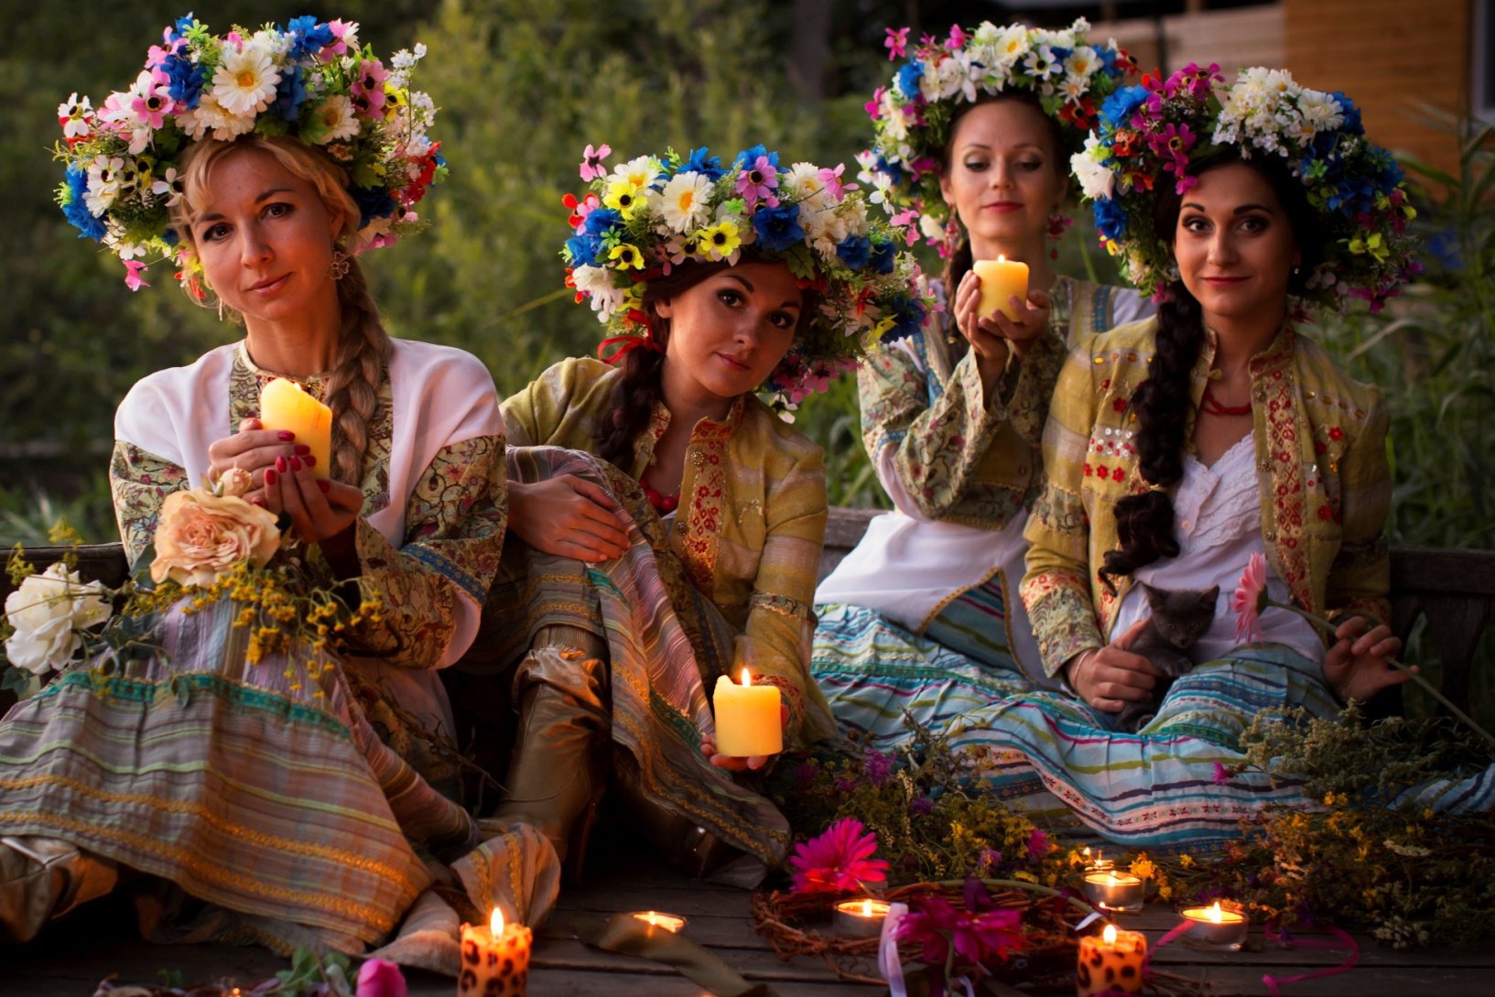
National holidays

Slide 9

Fashionable clothes

Slide 10
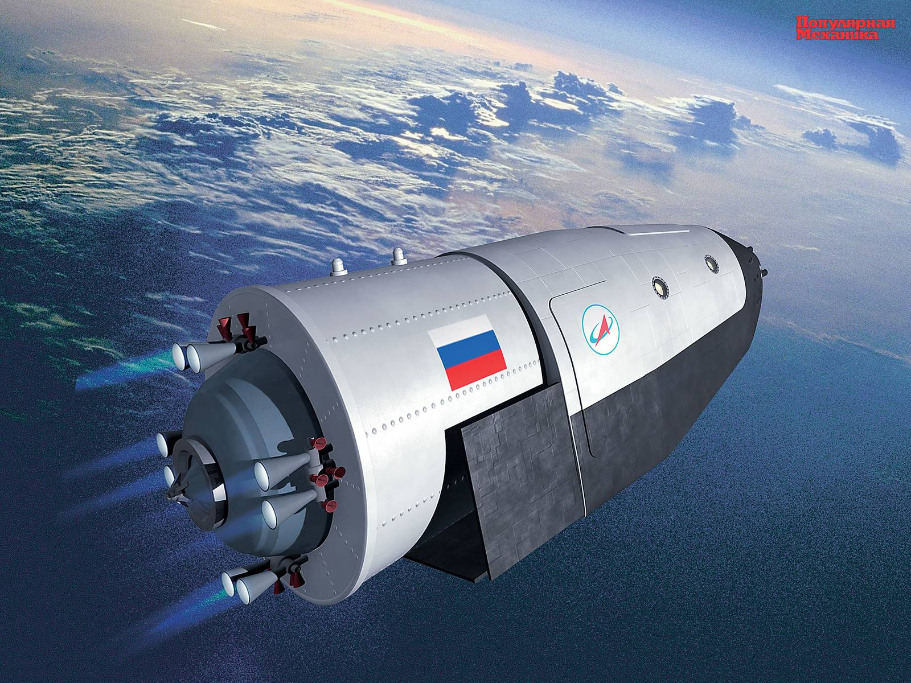
spaceship

Slide 11
Match the words and phrases which have a similar meaning.
1. something you see very often 1.find out
2 talking in a friendly way 2.express ourselves
3. worried 3.get in touch with
4. not able to see 4. amateur
5. created 5.distant
6. included 6.lit
7. say how we feel 7.chattering
8. not telling the truth 8. broadcast
9. not professional 9. types
10. kinds 10. lying
11. send out 11. concerned
12. started( a fire) 12. invented
13. learn information 13. blind
14. far away 14 contained
15. contact 15. common sight

Slide 12
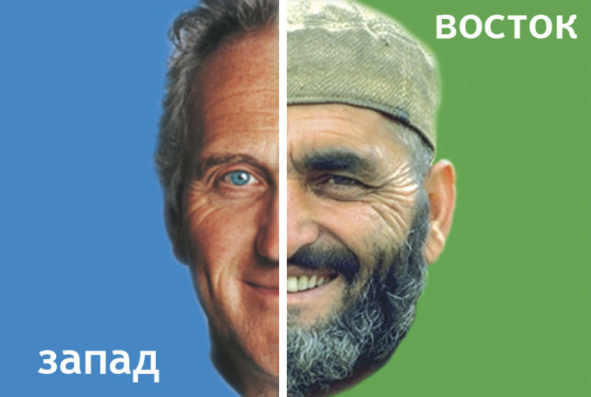
East or west, home is best

